Slide 1
Lecture 4 – Work Breakdown Structure (WBS)
Notes:
WBS is an important tool for Systems Engineering. This lecture will explain what they are and how to build them and use them.

Slide 2
Work Breakdown Structure (WBS)
Technique originally developed by financial specialists to track everyplace a program or project spent money or anticipated a need to spend money
  A control mechanism to make sure project cost estimates didn’t forget anything
  A control mechanism to make sure they understood where all the money went
This mechanism has been appropriated by project engineers and system engineers to make sure that all effort required for program or project has been accounted for and tracked
  A great way to find out if a project is in trouble when effort projected in area of the WBS is exceeding projections

Slide 3
What’s a WBS ?
A simple hierarchical breakdown of the effort anticipated to perform an effort
Typically in a tree
Often numeric designations are given to each block and used as accounting codes for charging time and materials
For us, a WBS demonstrates that we’ve thought of all the work we’re going to need to do to accomplish a project
  A laudable goal
The process of generating a WBS causes questions to be asked that discover required but unanticipated effort early enough in the process to deal with it
  Alternate design solutions that eliminate work
  Alter schedules to accommodate the work
  Seek additional resources
  Warn people of potential schedule delays
WBS helps you avoid the “I can’t stuff 5 lbs of candy into a 4 lb bag” problem late in a project

Slide 4
What is a WBS ?
A Work Breakdown Structure (WBS) is a fundamental project management technique for defining and organizing the total scope of a project, using a hierarchical tree structure.
The first two levels of the WBS (the root node and Level 2) define a set of planned outcomes that collectively and exclusively represent 100% of the project scope.
At each subsequent level, the children of a parent node collectively and exclusively represent 100% of the scope of their parent node.
A well-designed WBS describes planned outcomes instead of planned actions.
Outcomes are the desired ends of the project, and can be predicted accurately; actions comprise the project plan and may be difficult to predict accurately.
A well-designed WBS makes it easy to assign any project activity to one and only one terminal element of the WBS.
From Wikipedia

Slide 5
WBS Dictionary
A WBS dictionary is a document that has a paragraph or two describing the technical content of each element of the WBS
Because WBS element numbering and names can be cryptic, it is a good way to understand what is in the WBS

Slide 6
100% Rule
One of the most important WBS design principles is called the 100% Rule. The Practice Standard for Work Breakdown Structures (Second Edition), published by the Project Management Institute (PMI) defines the 100% Rule as follows:
The 100% Rule...states that the WBS includes 100% of the work defined by the project scope and captures all deliverables – internal, external, interim – in terms of the work to be completed, including project management.
The 100% rule is one of the most important principles guiding the development, decomposition and evaluation of the WBS.
The rule applies at all levels within the hierarchy: the sum of the work at the “child” level must equal 100% of the work represented by the “parent” and the WBS should not include any work that falls outside the actual scope of the project, that is, it cannot include more than 100% of the work…
From Wikipedia

Slide 7
100% Rule Example
Project
Parts A and B must add
up to 100% of the work
of the project
Part A
Part B
Parts B.1, B.2 and B.3 must add up to all of the work in Part B
Part A.1
Part A.2
Part B.1
Part B.2
Part B.3

Slide 8
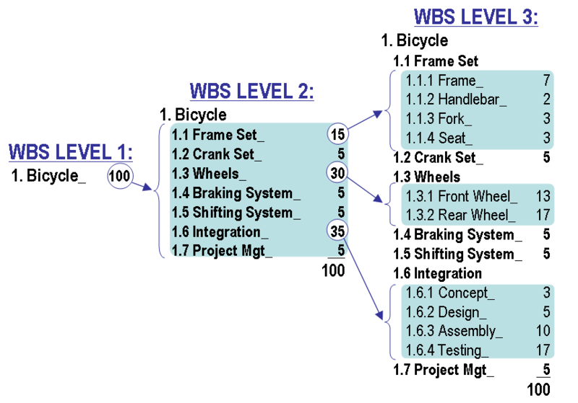
Figure 1: WBS Construction Technique. This exemplary WBS is from PMI's Practice Standard for Work Breakdown Structures (2nd Edition).
From Wikipedia
Notes:
Systems Engineering in this bicycle project might include establishing the design environment (storage indoor or outdoor for example), establishing requirements (adult or child sized), human interfaces (how long is th eleg of the adult or chikd), establishing a target weight for the bicycle and tracking the weights of the parts to give a predicted weight, modeling the performance of the bicycle to determine how fast it can go given the weight, size of operator, gear system, etc….
1.8 Systems Engineering
1.8 Systems Engineering

Slide 9
How to Build a WBS
List all the anticipated work for the project
  Identify all parts to be built
    Include design, materials and manufacturing
  Include analysis, assembly, integration and test
  Include project management, systems engineering and indirect costs (facility costs, utilities)
Organize the work into bins of related work
Place bins into a hierarchy
Apply a numbering system

Slide 10
Examples of WBS

Slide 11
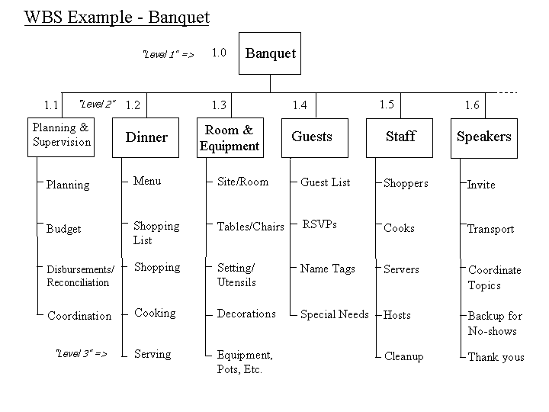
http://www.hyperthot.com/pm_wbs.htm
Notes:
A WBS example for giving a banquet.

Slide 12
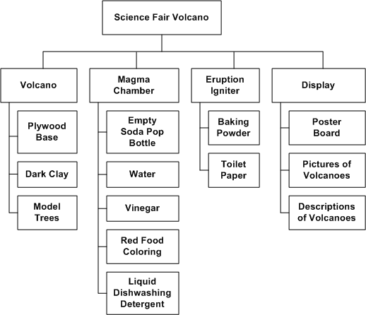
http://www.opfro.org/index.html?Components/WorkProducts/ManagementSet/WorkBreakdownStructure/WorkBreakdownStructure.html~Contents
Notes:
This is a great example of a WBS for the classic science fair volcano project.

Slide 13
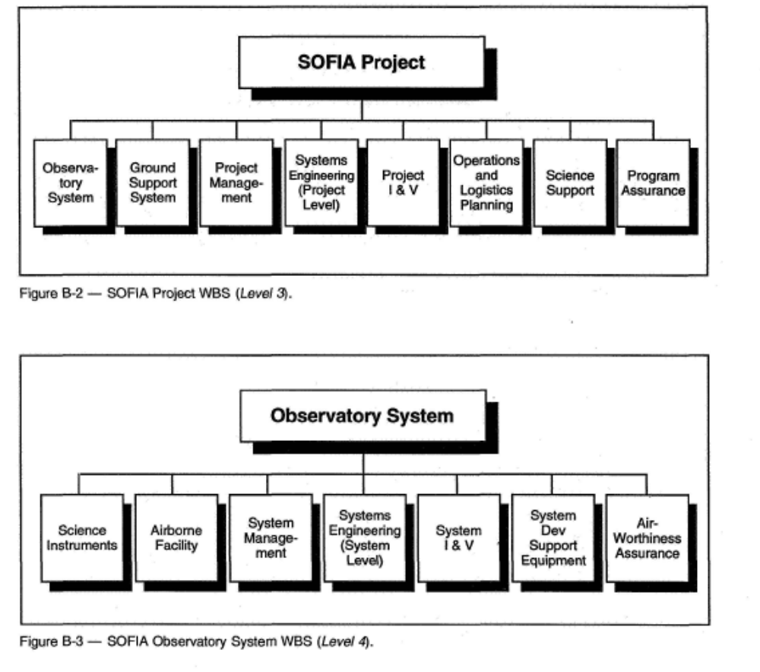

Note – Systems
Engineering at
4 different levels
Project - integrating all of the systems of the project
Observatory System – integrating all of the parts of the observatory – instruments and facility
Airborne Facility Segment – integrating all of the parts on the aircraft
Telescope Element
- integrating the parts of the telescope
Notes:
The SOFIA is a 747 aircraft operated by NASA that contains a large infrared telescope. By mounting the telescope on an aircraft, it can place the aircraft in the stratosphere (above 35,000 feet) above most of the atmosphere which interferes with ground based observation. By placing it on an aircraft it can also move to the best conditions for making an observations.
For the telescope to work, it has a huge door in the side of the aircraft which opens inflight. This introduces all sorts of problems. In addition to being exposed to low pressure and cold temperatures at altitude, the telescope cavity has to deal with vibrations and acoustical energy.
This WBS shows how systems engineering and integration must exist at multiple levels in a project in order to perform different types of integration. At the project level, the observatory, the ground support systems, logistics and other items must be integrated. At the observatory level, the aircraft observatory and the science instruments have to be integrated. At the airborne facility level, the telescope and the aircraft have to be integrated. At the telescope level, the telescope and its control consoles and electronics must be integrated.

Slide 14
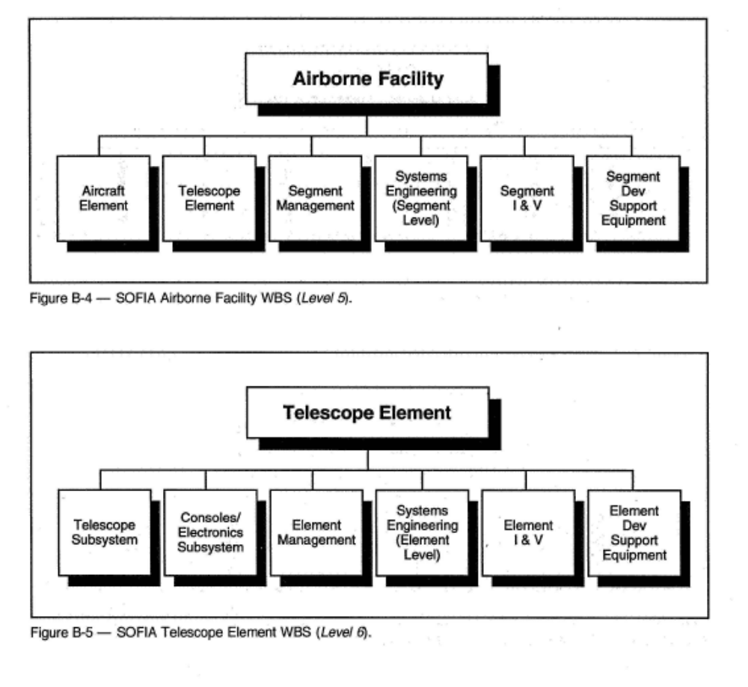
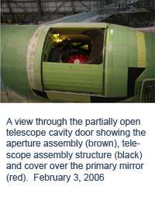

Slide 15
Why is a WBS Important to a Systems Engineer ?
The proper way to get effort budgeted in a big project is to get it into the WBS – so if you want systems engineering to have a budget, need to understand the WBS
Systems Engineering effort may exist at many levels in the project, examining the WBS allows you to see where you need to insert Systems Engineering effort
If Systems Engineering is going to integrate a project, it needs to know what is going on. The budgeted effort is reflected in a WBS. The WBS is the place to see where effort is being expended that may require integration.
It is a good place to start for building technical budgets, like weight or electrical power
Systems Engineers are always heavily involved in cost estimating and scheduling and the WBS is a good tool for both of these efforts

Slide 16
Rules for WBS
A WBS is not an exhaustive list of work. It is instead a comprehensive classification of project scope.
A WBS is not a project plan or a project schedule and it is not a chronological listing.
  It is considered poor practice to construct a project schedule before designing a proper WBS.
  This would be similar to scheduling the activities of home construction before completing the house design.
  Without concentrating on planned outcomes, it is very difficult to follow the 100% Rule at all levels of the WBS hierarchy.
A WBS is not an organizational hierarchy.
  Some practitioners make the mistake of creating a WBS that shadows the organizational chart.
  While it is common for responsibility to be assigned to organizational elements, a WBS that shadows the organizational structure is not descriptive of the project scope and is not outcome-oriented.
From Wikipedia

Slide 17
Rules for WBS
Short-term memory capacity should not dictate the size and span of a WBS tree structure.
  Some reference materials suggest that each WBS level be limited to 5-9 elements because that is a theoretical limit to short-term memory.
  Such advice is a misapplication of The Magical Number Seven, Plus or Minus Two, because WBS elements are not random unconnected data.
  Definitive references regarding WBS construction do not contain such advice.
  It is far more important to construct a logical grouping of planned outcomes than to worry about the limits of short-term human memory.
WBS updates, other than progressive elaboration of details, require formal change control.
  This is another reason why a WBS should be outcome-oriented and not be prescriptive of methods.
  Methods can, and do, change frequently, but changes in planned outcomes require a higher degree of formality.
  If outcomes and actions are blended, change control may be too rigid for actions and too informal for outcomes.
From wikipedia

Slide 18
WBS Rules
In addition to the 100% Rule, it is important that there is no overlap in scope definition between two elements of a WBS.
  This ambiguity could result in duplicated work or miscommunications about responsibility and authority.
  Likewise, such overlap is likely to cause confusion regarding project cost accounting.
  If the WBS element names are ambiguous, a WBS dictionary can help clarify the distinctions between WBS elements.
  The WBS Dictionary describes each component of the WBS with milestones, deliverables, activities, scope, and sometimes dates, resources, costs, quality, etc.
From wikipedia

Slide 19
Once you have the WBS
If you make each element a row in a spreadsheet
  Don’t forgot the non-hardware items such as software, analysis, test, integration and project management
And make each column the appropriate unit of time (month, year) that you use for accounting/budgeting
Then you can fill in each cell with your method for estimating cost for that item for that year
  Called a Cost Estimating Relationship (CER)
  CER’s can also include the escalation due to inflation
You can then apply time value of money equations from previous lectures to account for effects of inflation
Then if you sum columns, you get yearly budget
If you sum rows, you get total estimated cost for each item in the WBS
Once you have a WBS, you have the elements to build a schedule
  There should be a schedule with milestones for every item in the WBS

Slide 20
Any Questions ?

